Slide 1
AMAZON PRODUCT DATASET
A DATA SCIENCE STUDY
KHETANI, CHIRAG
BADVE, SAGAR
ANG, DOMINIQUE
BHARADWAJ, PRATHAM

Slide 2
Amazon dataset
Contributed by Julian McAuley, assistant professor at University of California, San Diego
Has over 142 million reviews spanning from 1996 to 2014
Will focus only on the cellphone and accessories category from 2003 to 2014

Slide 3
Challenges Faced
Defining our intention for the study.
Determining which attributes to take into account.
Combining three million reviews with its corresponding metadata as it takes a good amount of time and memory to process these datasets
Pre-processing the review text

Slide 4
Objectives of the study
Identify product features and opinions from the reviews
Perform topic modeling and analysis
Predict ratings on the product categories based on reviewer emotions

Slide 5
Data Preparation
Combined review data and metadata through common key
(ASIN - product ID)
Filtered the combined dataset by category
Removed missing values in attributes “Title” and “ReviewText”
Removed punctuations and stopwords
After pre-processing steps:
159,000 cellphone reviews

Slide 6
Sample combined review
ASIN: | B00009PGN0
Helpful: | [2, 2]
Overall: | 5
reviewText: | Product came exactly as described and would recommend getting this if you like yourself a galaxy s3 and I would give this product a 5 star
reviewTime: | 03 10, 2014
reviewerID: | A2BX7ST3X0L67G
reviewerName: | Dustin
Summary: | Great
unixReviewTime: | 1.06E+09
Price: | 284.49
salesRank:
Description: | Brand New Unlocked Camera: 8 MP, 3264x2448 pixels, autofocus, LED flash Card slot - microSD, up to 64 GB Super AMOLED capacitive touchscreen, 16M colors Dimensions - 136.6 x 70.6 x 8.6 mm (5.38 x 2.78 x 0.34 in)
Brand: | Samsung
Related: | {'bought_together': ['B008DM10WE'], 'also_viewed': ['B008OK8IIY', 'B008MC3N34', 'B00B472RVS', 'B00GS19754', 'B00DBHPCT8', 'B0096DYA8U', 'B008A9CZCY', 'B0096DWZ82'']}
imURL: | http://ecx.images-amazon.com/images/I/51hAD8gsrqL._SY300_.jpg
Categories: | [['Cell Phones & Accessories', 'Cell Phones', 'Unlocked Cell Phones']]
Title: | Samsung Galaxy S III I747 New Unlocked 16GB - Blue

Slide 7
Analysis and Results

Slide 8
Product Development Life Cycle (PDLC)
PDLC - collects parts failure/customer review data, starting from product development to field failure.
Field failure has two source
Service Center – Structured data/semi structured
Customer reviews - Unstructured data

Slide 9
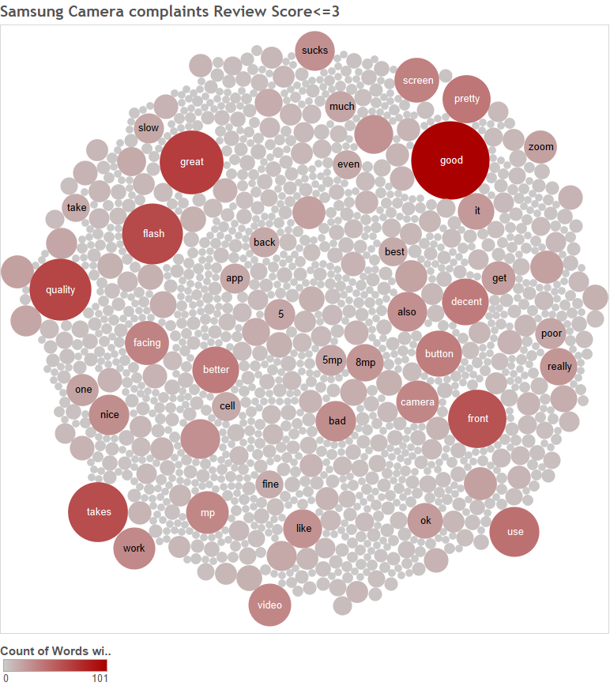
PDLC - Samsung Camera complaint
Select Part/Feature
name
Search the part/
feature in review text
If present, select 2
words before
and after the part/
feature name
Convert into structured data - matrix part
vs word count

Slide 10
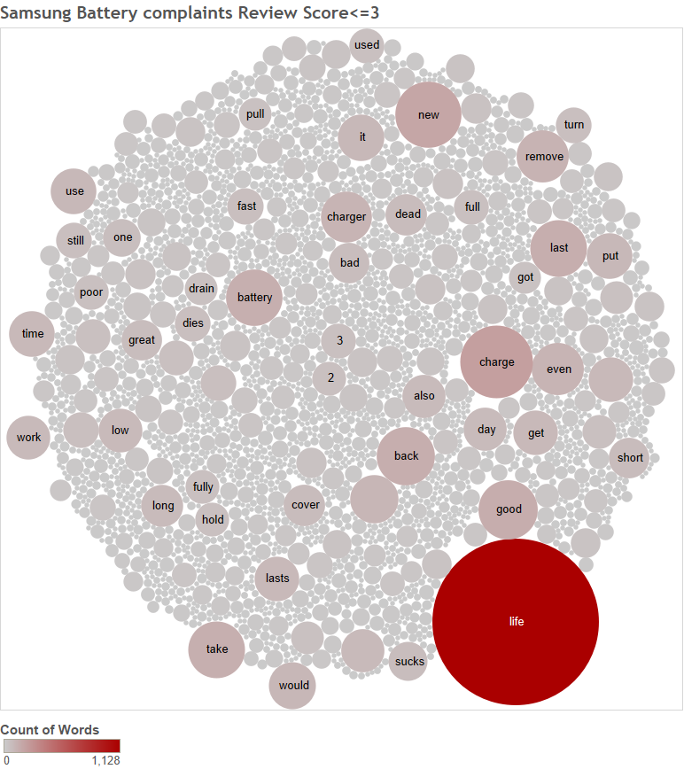
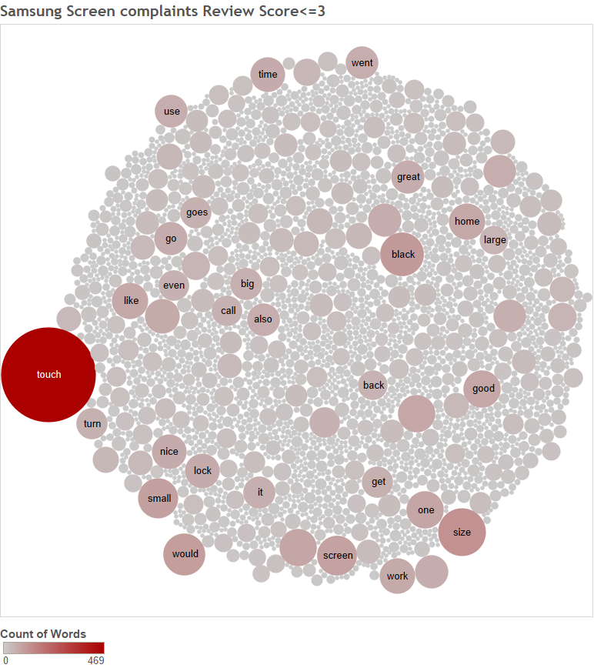
PDLC - Battery and Screen complaints
Samsung Battery Complaints
Samsung Screen Complaints

Slide 11
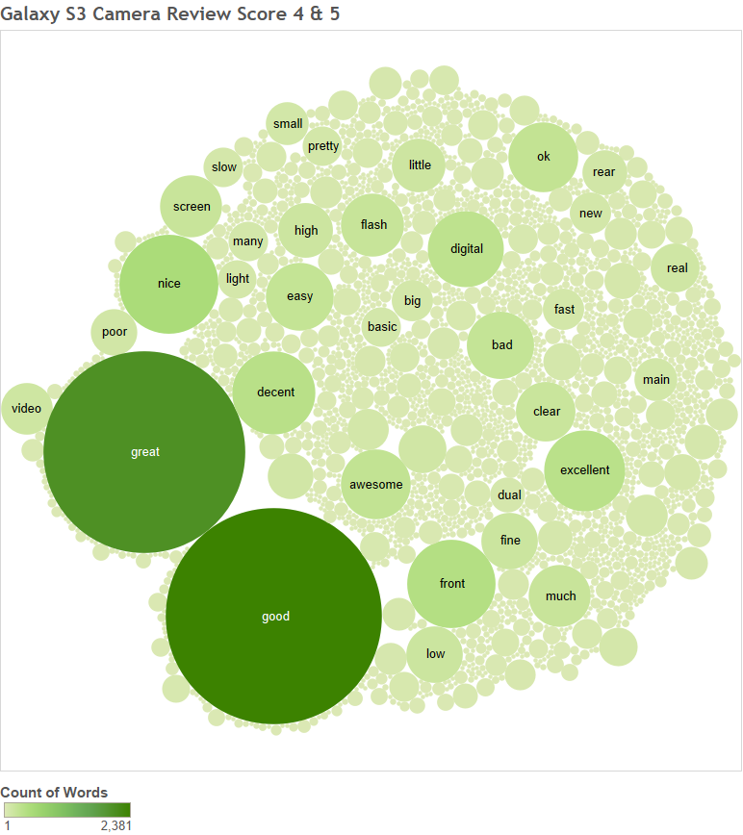
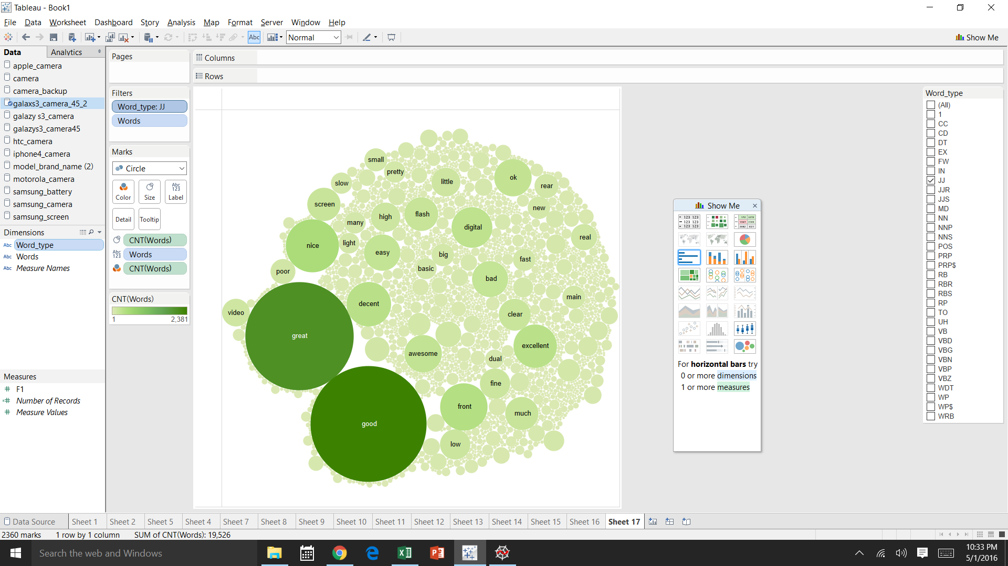
PDLC - Samsung Galaxy S3 Camera +ve(4 & 5) review

Slide 12
PDLC
Usage
For developing new products
To improve current products
Improvement scope
Can be integrated with sentimental analysis.
Domain specific sentiment words can be made.

Slide 13
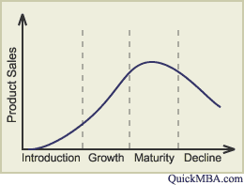
Product Life Cycle (PLC) - Prediction

Slide 14
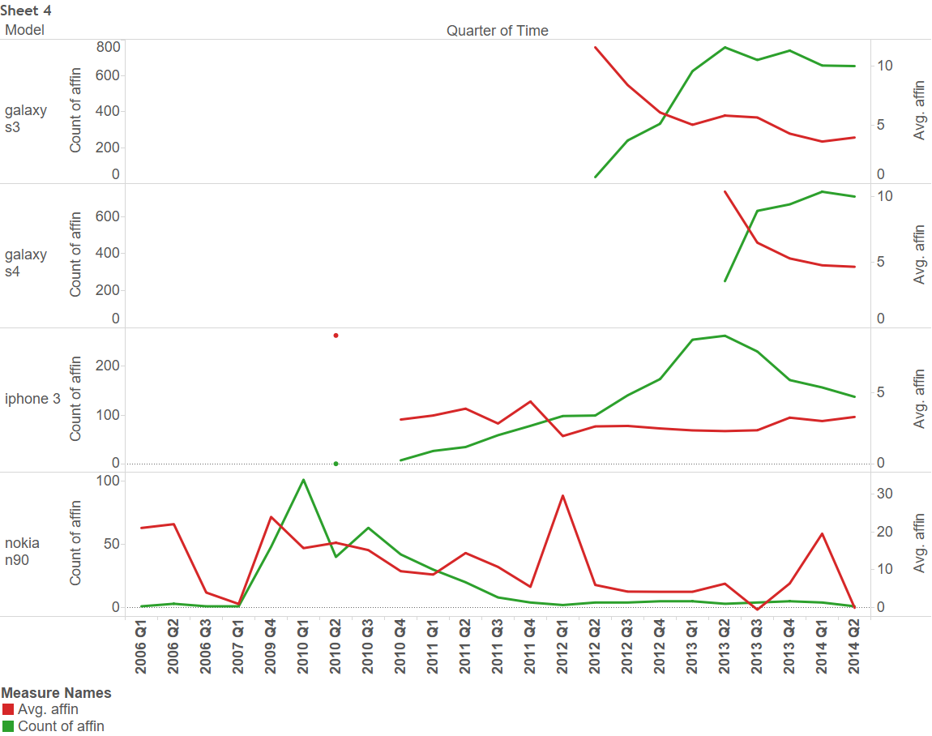
PLC - Prediction

Slide 15
PLC - Prediction
Usage
Helps in deciding when to launch new
product.
Improvement scope
Sales data can be used with this analysis.
Sentimental analysis can be improved.

Slide 16
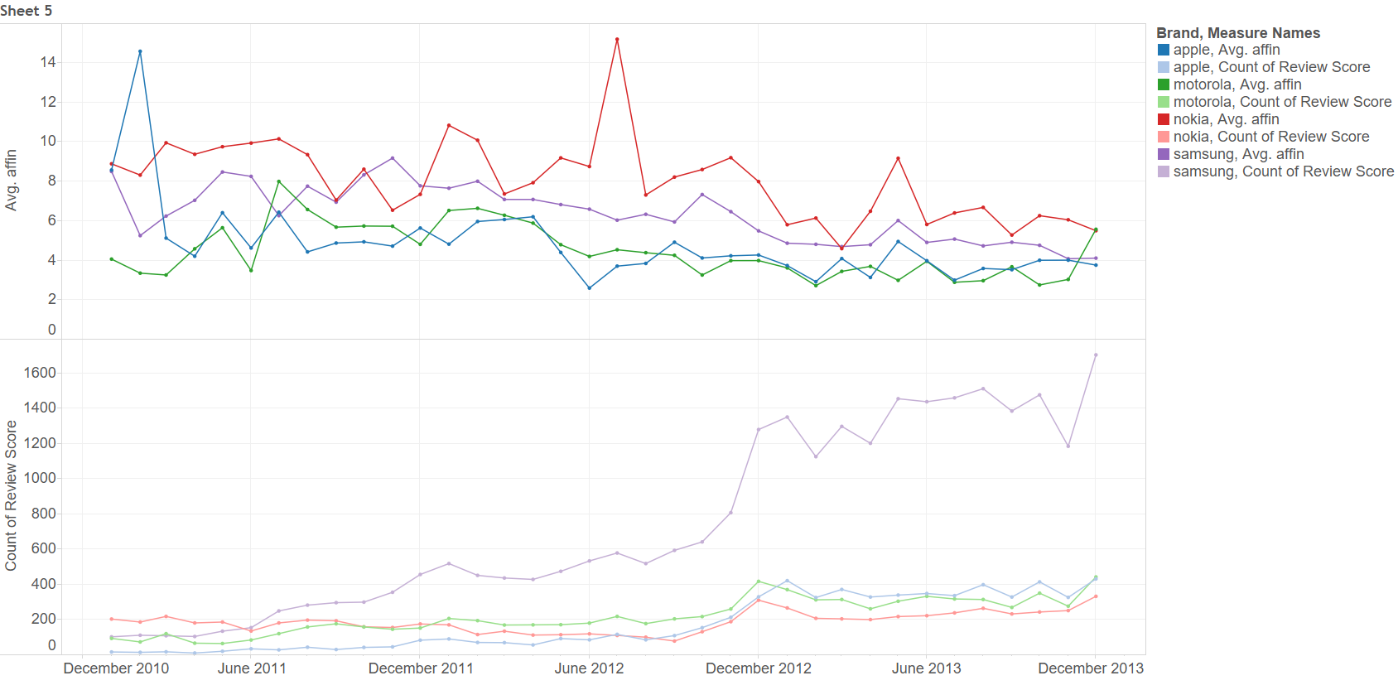
Brand wise sentiment analysis

Slide 17
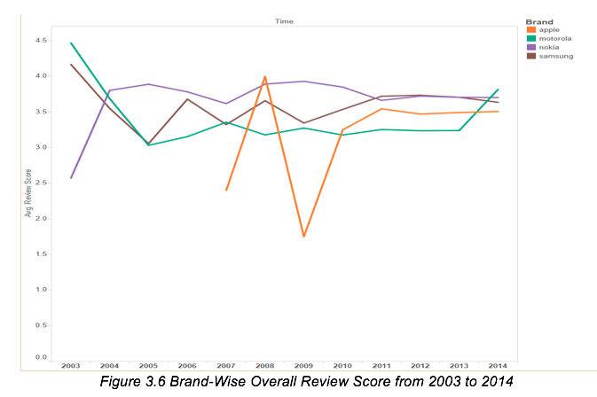
Brandwise phase analysis

Slide 18
TOPIC MODELING ON BRAND REVIEWS
To get the top best words, we performed topic modelling using NMF based upon reviews of Motorola, Apple, Nokia and Samsung. We selected 1 topic with 20 words from each brand.
Results:
•Topic 0: phone motorola use good like just battery great phones time new camera don service screen ve calls work really razr
•Topic 1: phone iphone unlocked seller apple new good work money 3g used like product amazon just working did use great 3gs
•Topic 2: phone nokia use good great camera like just battery phones e71 screen quality features time really gps don works bluetooth
•Topic 3: phone samsung great use good screen like camera just phones ve battery mobile time reception quality features really mp3 don

